Slide 1
System Analysis and Design
CSE 307 Sec 1
Instructor: Sabrina Alam
Lecture 12
Designing Databases

Slide 2
Learning Objectives
Understand database concepts.
Use normalization to efficiently store data in a database.
Use databases for presenting data.
Understand the concept of data warehouses.
Comprehend the usefulness of publishing databases to the Web.
Understand the relationship of business intelligence to data warehouses, big data, business analytics and text analytics in helping systems and people make decisions.

Slide 3
Major Topics
Databases
Normalization
Key design
Using the database
Data warehouses
Data mining
Business intelligence

Slide 4
Data Storage
The data must be available when the user wants to use them
The data must be accurate and consistent
Efficient storage of data as well as efficient updating and retrieval
It is necessary that information retrieval be purposeful
Notes:
Data storage is considered to be the heart of an information system.
The information obtained from the stored data must be in a form useful for managing, planning, controlling, or decision making.

Slide 5
Data Storage (continued)
There are two approaches to the storage of data in a computer-based system:
  Store the data in individual files, each unique to a particular application
  Store data in a database
    A database is a formally defined and centrally controlled store of data intended for use in many different applications
Notes:
File system advantages:
can be designed and build rapidly
any concerns about data availability and security can be minimized
File system disadvantages:
often designed only with immediate needs in mind
expensive programming time for file and program development and maintenance
stored data will be redundant
updating files is more time consuming
data integrity is an issue

Slide 6
Databases
Effectiveness objectives of the database:
  Ensuring that data can be shared among users for a variety of applications
  Maintaining data that are both accurate and consistent
  Ensuring data required for current and future applications will be readily available
  Allowing the database to evolve as the needs of the users grow
  Allowing users to construct their personal view of the data without concern for the way the data are physically stored
Notes:
A database is a central source of data meant to be shared by many users for a variety of applications.

Slide 7
Reality, Data, and Metadata
Reality
  The real world
Data
  Collected about people, places, or events in reality and eventually stored in a file or database
Metadata
  Information that describes data

Slide 8
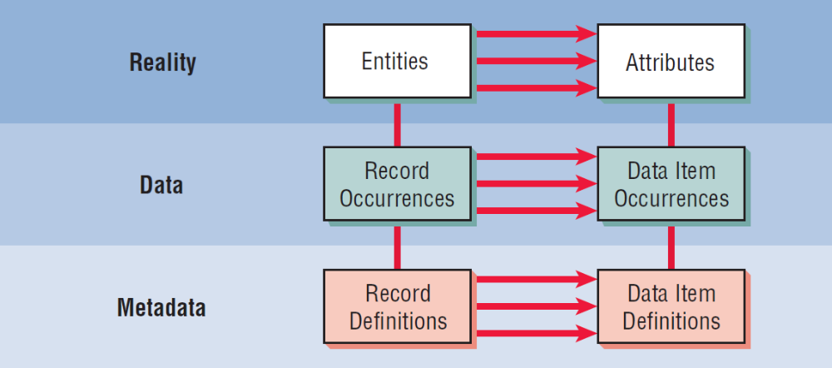
Reality, Data, and Metadata (Figure 13.1)
Notes:
Within the realm of reality are entities and attributes; within the realm of actual data are record occurrences and data item occurrences; within the real of metadata are record definitions and data item definitions.

Slide 9
Entities
Any object or event about which someone chooses to collect data
May be a person, place, or thing
May be an event or unit of time
Notes:
Examples:
a salesperson
a city
a product
machine breakdown
a sale
a month or year

Slide 10
Entity Subtype
An entity subtype is a special one-to-one relationship used to represent additional attributes, which may not be present on every record of the first entity
This eliminates null fields stored on database tables
For example, students who have internships: the STUDENT MASTER should not have to contain information about internships for each student

Slide 11
Relationships
Relationships
  One-to-one
  One-to-many
  Many-to-many
A single vertical line represents one
A crow’s foot represents many
13-<number>
Notes:
Relationships are associations between entities.
Self-join relationship—an entity with a relationship connecting to itself.

Slide 12
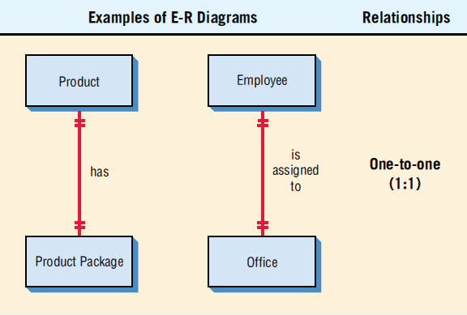
Entity-Relationship Diagrams Associations
(Figure 13.2, Part 1)
Entity-relationship (E-R) diagrams can show one-to-one, one-to-many, or many-to-many associations
13-<number>

Slide 13
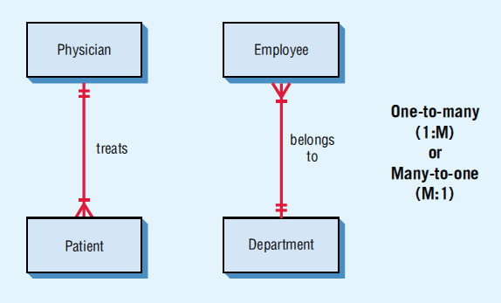
Entity-Relationship Diagrams Associations
(Figure 13.2, Part 2)
Entity-relationship (E-R) diagrams can show one-to-one, one-to-many, or many-to-many associations
Kendall & Kendall Copyright © 2014 Pearson Education, Inc. Publishing as Prentice Hall
13-<number>

Slide 14
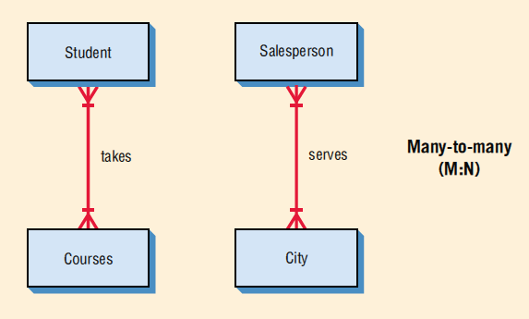
Entity-Relationship Diagrams Associations
(Figure 13.2, Part 3)
Entity-relationship (E-R) diagrams can show one-to-one, one-to-many, or many-to-many associations

Slide 15
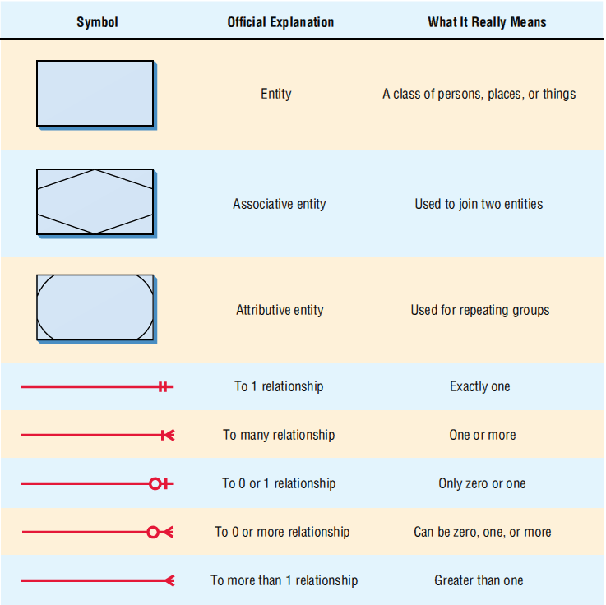
Entity-Relationship Symbols and Their Meanings (Figure 13.3)
Notes:
Associative entity—used to join two entities.
Attributive entity—used for repeating groups.

Slide 16
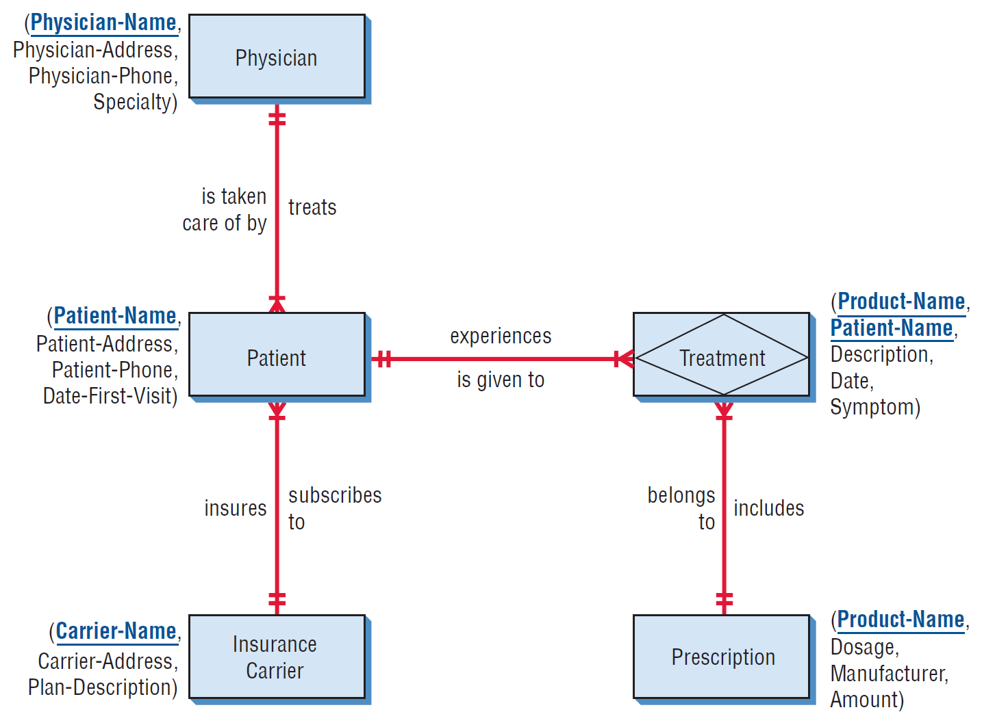
The Entity-Relationship Diagram for Patient Treatment (Figure 13.4)
Attributes can be listed alongside the entities.
The key is underlined.
Notes:
The attributes are listed next to each of the entities, and the key is underlined.

Slide 17
Attributes, Records, and Keys
Attributes represent some characteristic of an entity
Records are a collection of data items that have something in common with the entity described
Keys are data items in a record used to identify the record
Notes:
Data item is used interchangeably with attribute.

Slide 18
Key Types
Key types are:
  Primary key—unique attribute for the record
  Candidate key—an attribute or collection of attributes, that can serve as a primary key
  Secondary key—a key which may not be unique, used to select a group of records
  Composite key—a combination of two or more attributes representing the key
Notes:
A primary key should be minimal and contain no extra attributes than are necessary to identify a record.

Slide 19
Metadata
Data about the data in the file or database
Describe the name given and the length assigned each data item
Also describe the length and composition of each of the records

Slide 20
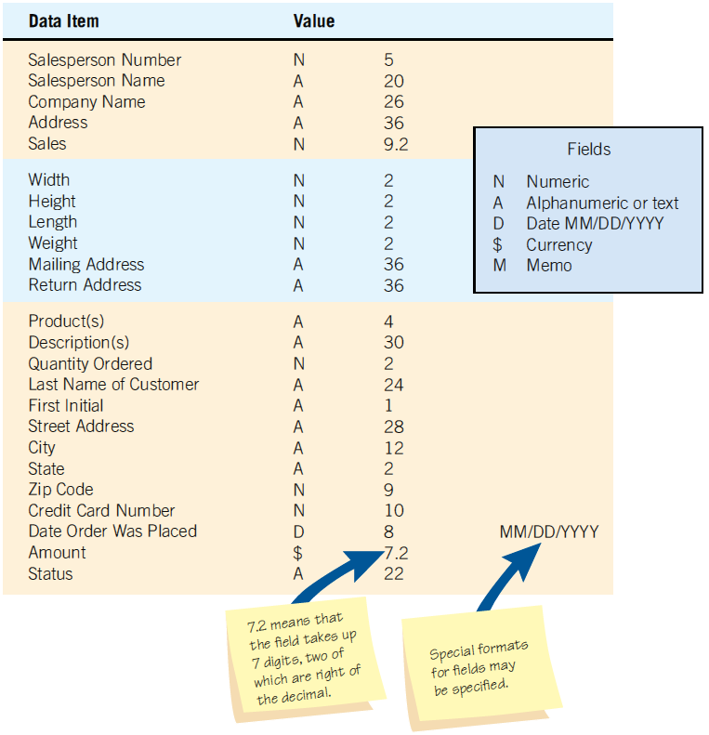
Metadata (Figure 13.7)
Metadata includes a description of what the value of each data item looks like.

Slide 21
Files
A file contains groups of records used to provide information for operations, planning, management, and decision making
Files can be used for storing data for an indefinite period of time, or they can be used to store data temporarily for a specific purpose

Slide 22
File Types
Master file
Table file
Transaction file
Report file

Slide 23
Master and Table Files
Master files:
  Contain records for a group of entities
  Contain all information about a data entity
Table files:
  Contains data used to calculate more data or performance measures
  Usually read-only by a program
Notes:
Each record of a Master file generally contains a primary key and several secondary keys.
Examples:
patient records
customer records
a personnel file
a parts inventory.

Slide 24
Transaction and Report Files
Transaction records:
  Used to enter changes that update the master file and produce reports
Report files:
  Used when it is necessary to print a report when no printer is available
  Useful because users can take files to other computer systems and output to specialty devices

Slide 25
Relational Databases
A database is intended to be shared by many users
There are three structures for storing database files:
  Relational database structures
  Hierarchical database structures
  Network database structures
Notes:
An analyst today would typically design a relational database.

Slide 26
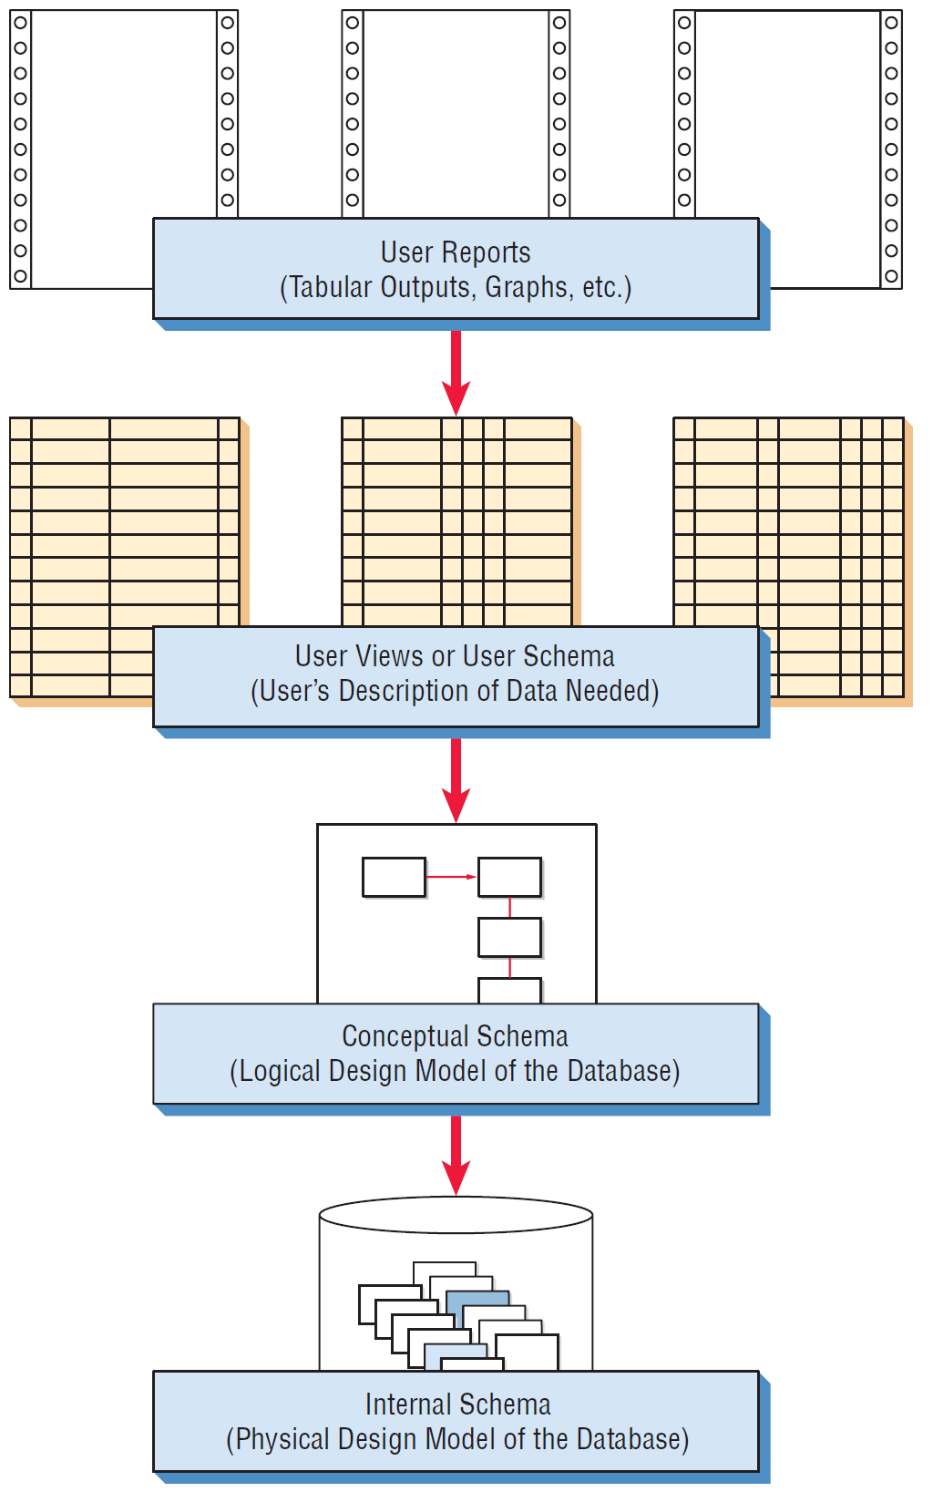
Database Design (Figure 13.8)
Database design includes synthesizing user reports, user views, and logical and physical designs

Slide 27
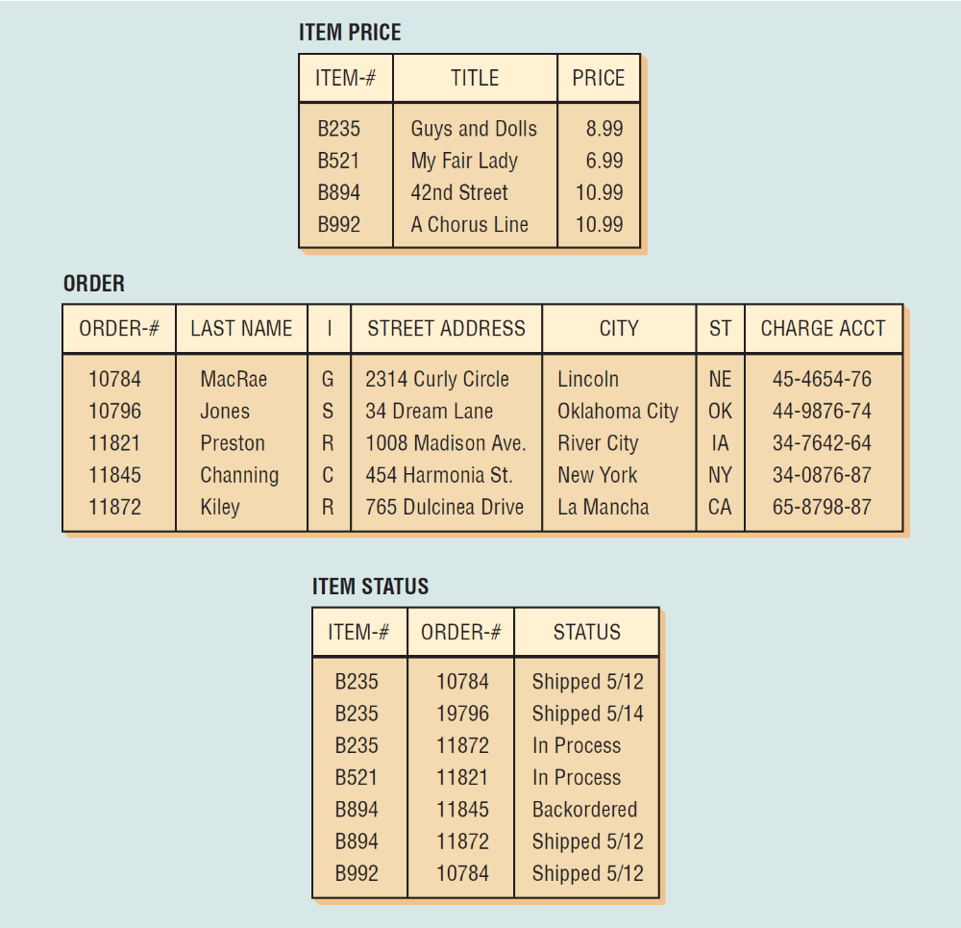
Relational Data Structure (Figure 13.9)
In a relational data structure, data are stored in many tables.
13-<number>

Slide 28
Normalization
Normalization is the transformation of complex user views and data stores to a set of smaller, stable, and easily maintainable data structures
The main objective of the normalization process is to simplify all the complex data items that are often found in user views
Notes:
For relational tables to be useful and manageable, the relational tables must first be normalized.

Slide 29
Normalization
Step 1: remove all repeating groups and identify the primary key—the relation needs to be broken up into two or more relations (1NF)
Step 2: remove partial dependencies—ensures that all nonkey attributes are fully dependent on the primary key. All partial dependencies are removed and placed in another relation.
Step 3: remove any transitive dependencies—one in which nonkey attributes are dependent on other nonkey attributes.
Notes:
For relational tables to be useful and manageable, the relational tables must first be normalized.

Slide 30
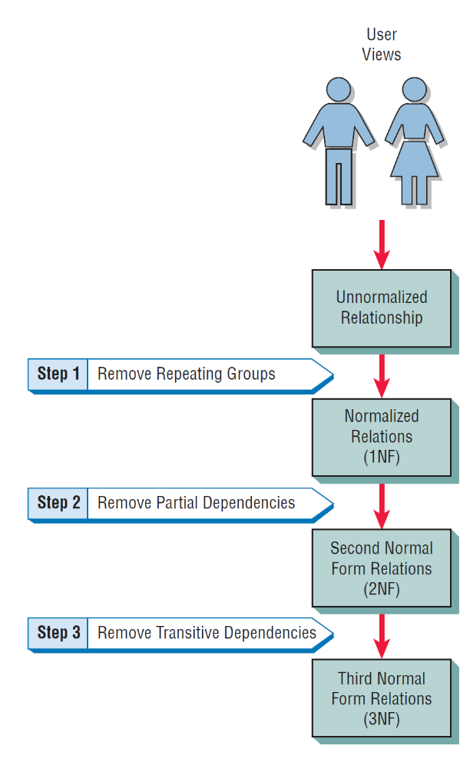
Normalization of a Relation Is Accomplished in Three Major Steps
(Figure 13.10)
Notes:
Step 1: remove all repeating groups and identify the primary key—the relation needs to be broken up into two or more relations (1NF)
Step 2: remove partial dependencies—ensures that all nonkey attributes are fully dependent on the primary key. All partial dependencies are removed and placed in another relation.
Step 3: remove any transitive dependencies—one in which nonkey attributes are dependent on other nonkey attributes.

Slide 31
Data Model Diagrams
Shows data associations of data elements
Each entity is enclosed in an ellipse
Arrows are used to show the relationships
Notes:
Although it is possible to draw these relationships with an E-R diagram, it is sometimes easier to use the simpler bubble diagram to model the data.

Slide 32
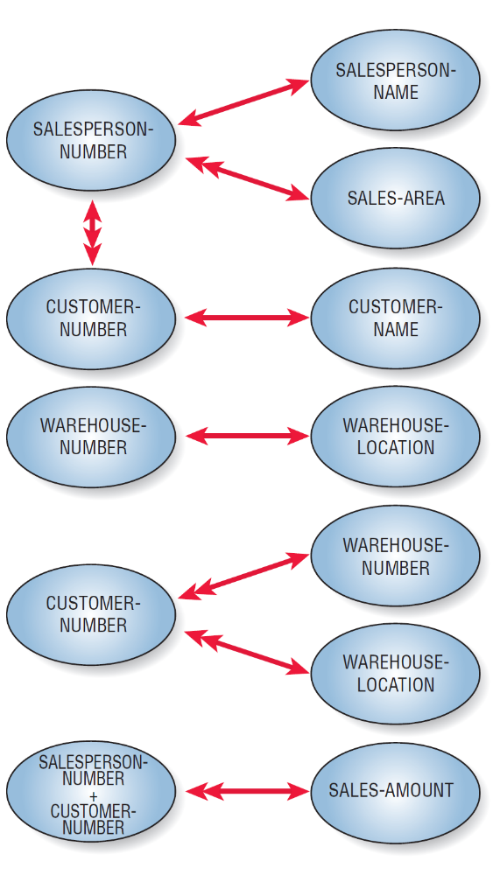
Drawing Data Model (Figure 13.13)
Drawing data model diagrams for data associations sometimes helps analysts appreciate the complexity of data storage.

Slide 33
First Normal Form (1NF)
Remove repeating groups
The primary key with repeating group attributes are moved into a new table
When a relation contains no repeating groups, it is in first normal form

Slide 34
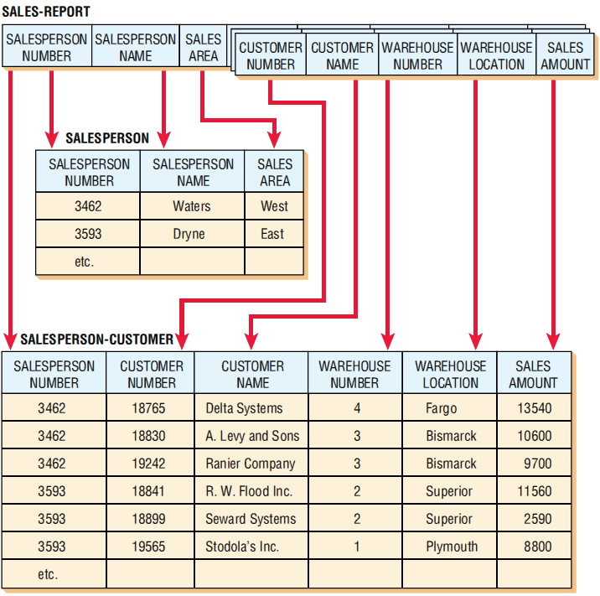
The Original Unnormalized Relation (Figure 13.16)
The original unnormalized relation SALES-REPORT is separated into two relations, SALESPERSON (3NF) and SALESPERSON-CUSTOMER (1NF).

Slide 35
Second Normal Form (2NF)
Remove any partially dependent attributes and place them in another relation
A partial dependency is when the data are dependent on a part of a primary key
A relation is created for the data that are only dependent on part of the key and another for data that are dependent on both parts

Slide 36
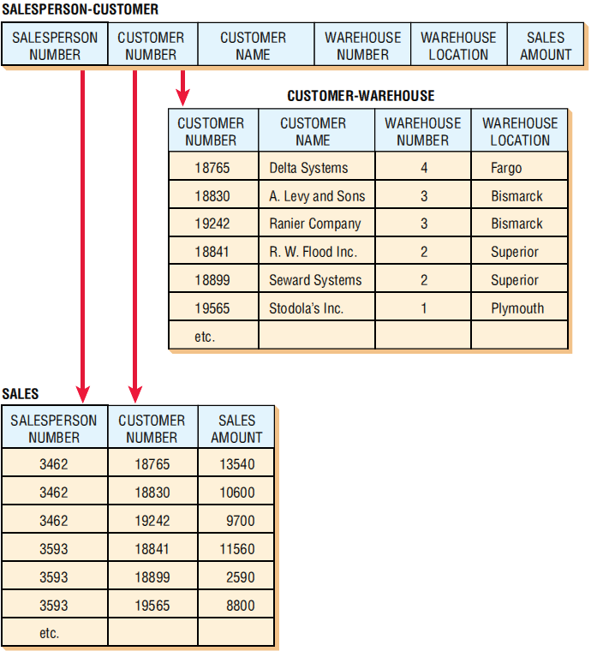
Second Normal Form (Figure 13.18 )
The relation SALESPERSON-CUSTOMER is separated into a relation called CUSTOMER-WAREHOUSE (2NF) and a relation called SALES (1NF).
Kendall & Kendall Copyright © 2014 Pearson Education, Inc. Publishing as Prentice Hall
13-<number>

Slide 37
Third Normal Form (3NF)
Must be in 2NF
Remove any transitive dependencies
A transitive dependency is when nonkey attributes are dependent not only on the primary key, but also on a nonkey attribute

Slide 38
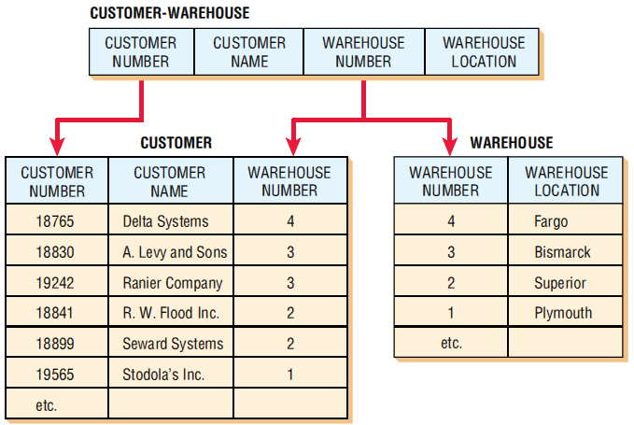
Third Normal Form (Figure 13.20)
The relation CUSTOMER-WAREHOUSE is separated into two relations called CUSTOMER (1NF) and WAREHOUSE (1NF).

Slide 39
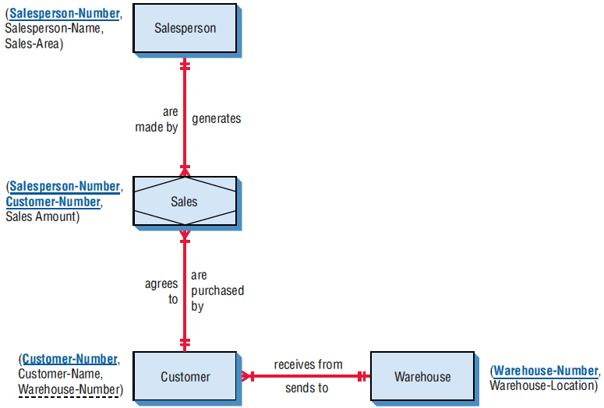
Al S. Well Hydraulic Company
E-R Diagram (Figure 13.22)

Slide 40
Using the Entity-Relationship Diagram to Determine Record Keys
When the relationship is one-to-many, the primary key of the file at the one end of the relationship should be contained as a foreign key on the file at the many end of the relationship
A many-to-many relationship should be divided into two one-to-many relationships with an associative entity in the middle

Slide 41
Guidelines for Master File/Database Relation Design
Each separate data entity should create a master database table
A specific data field should exist on one master table
Each master table or database relation should have programs to create, read, update, and delete the records

Slide 42
Integrity Constraints
Entity integrity
Referential integrity
Domain integrity

Slide 43
Entity Integrity
The primary key cannot have a null value
If the primary key is a composite key, none of the fields in the key can contain a null value

Slide 44
Referential Integrity
Referential integrity governs the nature of records in a one-to-many relationship
Referential integrity means that all foreign keys in the many table (the child table) must have a matching record in the parent table

Slide 45
Referential Integrity (continued)
Referential integrity implications:
  You cannot add a record in the child (many) table without a matching record in the parent table
  You cannot change a primary key that has matching child table records
  You cannot delete a record that has child records

Slide 46
Referential Integrity (continued)
Implemented in two ways:
  A restricted database updates or deletes a key only if there are no matching child records
  A cascaded database will delete or update all child records when a parent record is deleted or changed

Slide 47
Domain Integrity
Domain integrity rules are used to validate the data
Domain integrity has two forms:
  Check constraints, which are defined at the table level
  Rules, which are defined as separate objects and can be used within a number of fields

Slide 48
Anomalies
Data redundancy
Insert anomaly
Deletion anomaly
Update anomaly

Slide 49
Data Redundancy
When the same data is stored in more than one place in the database
Solved by creating tables that are in third normal form

Slide 50
Insert Anomaly
Occurs when the entire primary key is not known and the database cannot insert a new record, which would violate entity integrity
Can be avoided by using a sequence number for the primary key

Slide 51
Deletion Anomaly
Happens when a record is deleted that results in the loss of other related data

Slide 52
Update Anomaly
When a change to one attribute value causes the database to either contain inconsistent data or causes multiple records to need changing
May be prevented by making sure tables are in third normal form

Slide 53
Retrieving and Presenting Database Data
Choose a relation from the database
Join two relations together
Project columns from the relation
Select rows from the relation
Derive new attributes
Index or sort rows
Calculate totals and performance measures
Present data
Notes:
The first and last steps are mandatory, but the six steps in between are optional, depending on how data are to be used.

Slide 54
Denormalization
Denormalization is the process of taking the logical data model and transforming it into an efficient physical model

Slide 55
Data Warehouses and Database Differences
Data warehouses are used to organize information for quick and effective queries
In the data warehouse, data are organized around major subjects
Data in the warehouse are stored as summarized rather than detailed raw data
Data in the data warehouse cover a much longer time frame than in a traditional transaction-oriented database
Data warehouses are organized for fast queries

Slide 56
Data Warehouses and Database Differences (continued)
Data warehouses are usually optimized for answering complex queries, known as OLAP
Data warehouses allow for easy access via data-mining software
Data warehouses include multiple databases that have been processed so that data are uniformly defined
Data warehouses usually include data from outside sources

Slide 57
Online Analytic Processing
Online analytic processing (OLAP) is meant to answer decision makers’ complex questions by defining a multidimensional database

Slide 58
Data-Mining Decision Aids
Siftware
  Statistical analysis
  Decision trees
  Neural networks
  Intelligent agents
  Fuzzy logic
  Data visualization

Slide 59
Data-Mining Patterns
Associations—patterns that occur together
Sequences—patterns of actions that take place over a period of time
Clustering—patterns that develop among groups of people
Trends—the patterns that are noticed over a period of time

Slide 60
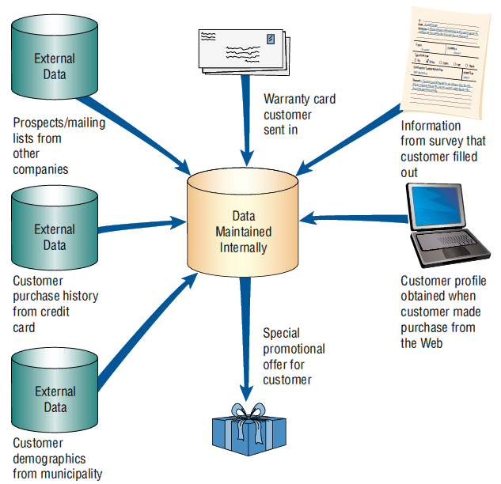
Data Mining (Figure 13.27)
Data mining collects personal information about customers in an effort to be more specific in interpreting and anticipating their preferences

Slide 61
Data-Mining Problems
Costs may be too high to justify
Has to be coordinated
Ethical aspects

Slide 62
Business Intelligence (BI)
Business intelligence is a decision support system (DSS) for organizational decision makers
It is composed of features that gather and
store data
It uses knowledge management approaches combined with analysis
This becomes input to decision makers’ decision-making processes

Slide 63
Business Intelligence
Business intelligence is built around processing large volumes of data
Big data is when data sets become too large or too complex to be handled with traditional tools or within traditional databases or data warehouses
Big data is a strategy that permits organizations to cope with ever-increasing numbers of data from a myriad of sources
  Human generated
  Generated via sensors of some type

Slide 64
Analyzing Business Intelligence
Five prominent methods are used for analyzing business intelligence
  Slice-and-dice drilldown
  Ad hoc queries
  Real-time analysis
  Forecasting
  Scenarios

Slide 65
Text Analytics
Text analytics is a way to structure the unstructured
Turning qualitative material into quantitative material
The broader view is to tap into qualitative unstructured data that can be of use to decision makers who must recommend courses of action to their organizations that are backed by data

Slide 66
Text Analytics Sources
Sources of big data for text analytics include unstructured, qualitative, or “soft,” data generated through:
  Blogs
  Chat rooms
  Questionnaires using open-ended questions
  Online discussions conducted on the Web
  Social media such as
    Facebook
    Twitter
    Other Web-generated dialogs between customers and an organization

Slide 67
Summary
Storing data
  Individual files
  Database
Reality, data, metadata
Conventional files
  Type
  Organization
Database
  Relational
  Hierarchical
  Network

Slide 68
Summary (continued)
E-R diagrams
Normalization
  First normal form
  Second normal form
  Third normal form
Denormalization
Data warehouse
Data mining

Slide 69

Copyright © 2014 Pearson Education, Inc.
Publishing as Prentice Hall
1-<number>

Slide 70
END OF
Lecture 12

